Slide 1
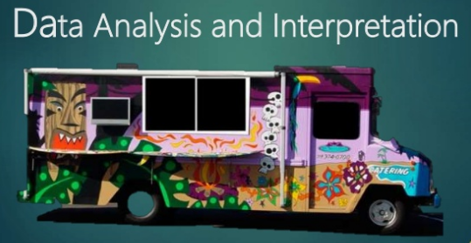

Project Report - Business Problem Analysis for recognizing areas to set up Food Trucks
- Savita Patil

Slide 2
Business Problem
The City of New York is famous for its excellent cuisine. It's food culture includes an array of international cuisines influenced by the city's immigrant history.
Food trucks have become very popular in the United States
Find a suitable location: If you plan a real Food trucks that can demand higher prices for fresh vegetables, delivered daily from Food trucks, focus on neighborhoods and outlets that already attract a sophisticated Food trucks client. If you plan a cheap buffet Food trucks, points to the masses looking for affordable high-traffic locations with large shopping centers and other local points of interest. So it is evident that to survive in such competitive market it is very important to strategically plan.

Slide 3
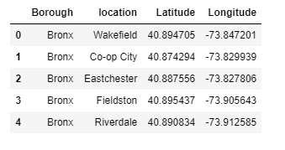
Cluster Areas:

Slide 4
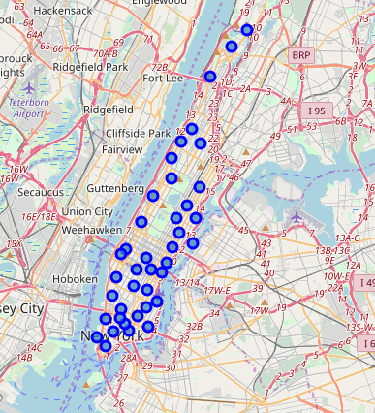
Foursquare API to explore neighborhoods in Bronx, New York

Slide 5
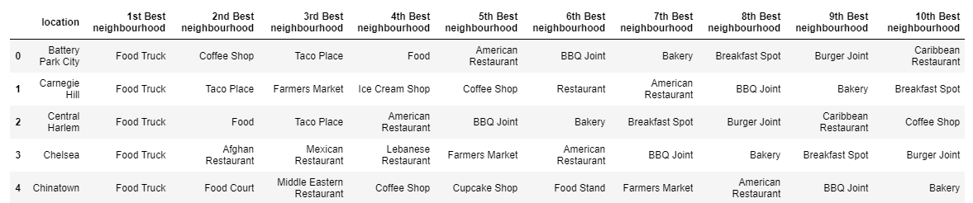
The neighborhood which is good for food truck when parking Restaurant business

Slide 6
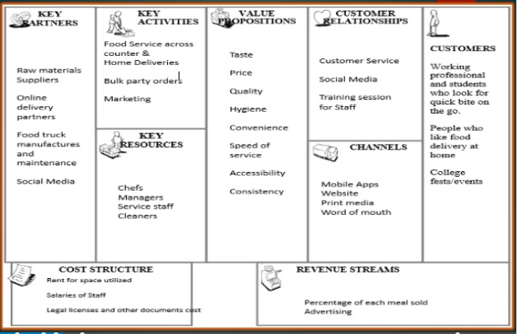

Slide 7
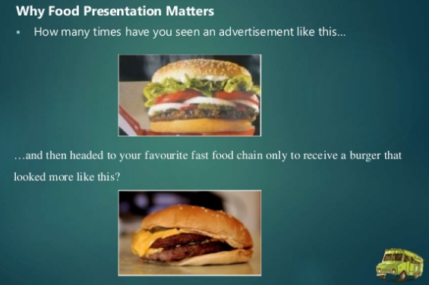

Slide 9
